Slide 1


NEXT GEN EMPLOYABILITY PROGRAM
CREATING A FUTURE-READY WORKFORCE
Student Name :
Ashish Madhup
Student ID :
STU65d65983d1ff51708546435
Mobile No:
6202556314
College Name :
Mail ID:
madhupashish@gmail.com
Gurukula Kangri (Deemed to be University)

Slide 2
CAPSTONE PROJECT SHOWCASE
Project Title
Health Care Data Driven Decisions using Power BI (DA)
Abstract | Problem Statement | Project Overview | Proposed Solution | Technology Used | Modelling & Results | Conclusion | Q&A

Slide 3
Abstract
1
"In week one, I organized raw data into a structured format suitable for data collection purposes."
2
"In week two, I developed the report view for the collected data."
3
"In week three, I focused on visualizing the collected data."
4
"In week four, I completed the entire project and conducted a comprehensive review."

Slide 4


Problem Statement
Healthcare organizations face challenges in harnessing the vast amount of data generated from patient records, medical tests, and treatment outcomes. The unstructured nature of raw data, reliance on manual reporting processes, and limited analytical capabilities hinder efficient decision-making. There's a critical need for a comprehensive solution that enables healthcare professionals to collect, organize, analyze, and visualize data effectively, driving improved patient outcomes and operational efficiency.

Slide 5

Project Overview
Our project aims to streamline healthcare data management and decision-making processes by leveraging advanced analytics and visualization techniques. We focus on transforming raw healthcare data into actionable insights through systematic data collection, organization, analysis, and visualization. By addressing the challenges of unstructured data, manual reporting, and limited analytical capabilities, our solution empowers healthcare organizations to make informed decisions, leading to improved patient outcomes and operational efficiency.

Slide 6
Proposed Solution
Our proposed solution entails the development and implementation of a robust healthcare data management platform powered by advanced analytics and visualization capabilities. Firstly, we will establish a systematic data collection process that integrates various sources of healthcare data, including patient records, medical tests, and treatment outcomes. This will involve the creation of standardized data schemas and protocols to ensure consistency and accuracy in data collection. Next, we will implement advanced analytics techniques to process and analyze the collected data. This includes leveraging machine learning algorithms to identify patterns, trends, and anomalies within the data, providing valuable insights into patient demographics, disease prevalence, treatment efficacy, and resource utilization. Furthermore, our solution will incorporate interactive data visualization tools to present the analyzed data in an intuitive and easily understandable format. Through dynamic dashboards and interactive reports, healthcare professionals will be able to explore and interpret complex datasets efficiently, facilitating informed decision-making. Additionally, our platform will feature predictive modeling capabilities to forecast future healthcare trends and outcomes. By analyzing historical data and applying predictive algorithms, healthcare organizations can anticipate patient needs, identify potential risks, and proactively plan interventions to improve patient outcomes and reduce healthcare costs. Moreover, our solution will prioritize data security and privacy, implementing robust encryption and access control mechanisms to safeguard sensitive healthcare information. Compliance with regulatory requirements such as HIPAA will be ensured to maintain patient confidentiality and trust. Overall, our proposed solution aims to revolutionize healthcare data management and decision-making processes, empowering healthcare organizations to harness the full potential of their data for improved patient care, operational efficiency, and strategic planning.

Slide 7
Technology used
1. Power BI: For dynamic data visualization and interactive dashboards.
2. Python: For advanced data manipulation, statistical analysis, and machine learning tasks.
3. SQL: For data querying and manipulation, particularly with relational databases.
4. Microsoft Azure: For cloud-based data storage, processing, and machine learning model deployment.
5. Machine Learning Algorithms: Utilized for extracting insights and building predictive models from healthcare data.
6. Data Encryption and Security Protocols: Implemented to ensure data security and regulatory compliance, such as HIPAA.

Slide 8
Modelling & Result
Modeling:
Our modeling approach involves applying statistical techniques and machine learning algorithms to analyze healthcare data efficiently. This includes:
1. Descriptive Modeling: Summarizing key data characteristics using descriptive statistics like mean, median, and variance.
2. Predictive Modeling: Forecasting future outcomes using regression, decision trees, and ensemble methods.
3. Segmentation Modeling: Grouping patients based on similarities using clustering algorithms.
4. Time Series Analysis: Identifying temporal patterns and trends in patient data over time.
5. Feature Engineering: Selecting and transforming relevant features to enhance model performance.
These modeling techniques enable us to extract valuable insights from healthcare data, supporting data-driven decision-making and improving patient outcomes.

Slide 9
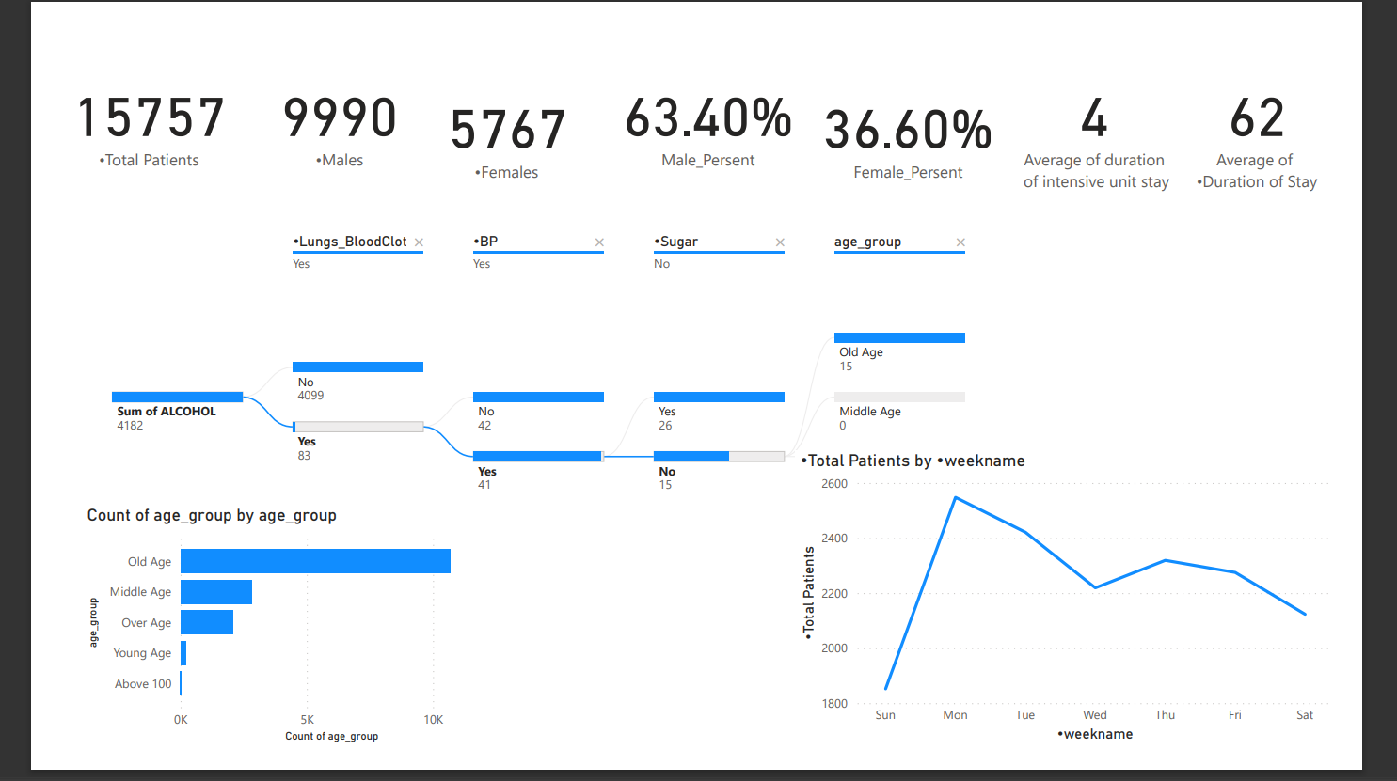
Modelling & Result

Slide 10
Modelling & Result
Results:
Our analysis provides actionable insights for healthcare decision-making:
1. Patient Outcome Predictions: Accurate forecasts aid in treatment planning.
2. Disease Trends Identification: Early detection supports preventive measures.
3. Resource Utilization Optimization: Efficient allocation enhances operational efficiency.
4. Personalized Treatment Strategies: Tailored approaches improve patient care.
5. Temporal Patterns Discovery: Trends inform seasonal healthcare planning.

Slide 11

Conclusion
Our project demonstrates the significance of leveraging data-driven approaches in healthcare decision-making. By effectively analyzing and visualizing healthcare data, we have shown the potential to improve patient outcomes, optimize resource utilization, and enhance overall healthcare delivery. Through advanced modeling techniques and insightful results, we have laid the foundation for future advancements in healthcare analytics. Moving forward, it is essential to continue refining and expanding these methodologies to address evolving challenges and opportunities in the healthcare landscape. Ultimately, our efforts aim to contribute to the advancement of healthcare systems worldwide, fostering a culture of innovation and excellence in patient care.

Slide 12


Notes:
Thank You !!

